Slide 1
Hampden County Sheriff’s Office Overview of Mental Health & Programs
Karen Donelson MA, NCC, LMHC
Clinical Supervisor

Slide 2
Overview
Hampden County sites
Mental Health Services
Suicide Prevention & Intervention
Evaluation and Stabilization Units
Specialized Units at HCSO
Educational and Treatment programs
Stonybrook Stabilization Center (Section 35)

Slide 3
Four Secure Sites of HCSO
Hampden County Correctional Center (Main Institution)
Ludlow MA
Western MA Regional Women’s Correctional Center
Chicopee MA (Serving Worcester West – exception Franklin)
Western Massachusetts Recovery and Wellness Center
Springfield MA (Local, DOC step-down & Federal step-down)
Stonybrook Stabilization Treatment Center
Ludlow MA (Section 35)

Slide 4
Open Mental Health Cases
Facility | # in Custody | Open w/ MHS | Percentage w/ MHS
Main Institution | 682 | 430 | 63.05%
WCC | 151 | 113 | 74.83%
WMRWC | 83 | 43 | 51.81%
SSTC | 107 | 90 | 84.11%
TOTALS | 916 | 586 | 63.97%
*Daily count and MH Numbers as of 11/28/23
Notes:
Cook County Jail, in Chicago, is the largest single-site jail in the United States. Because so many people with mental illness pass through their custody, Cook County Jail can also be considered the largest mental-health facility in the nation.

Slide 5
Collaborative Approach
Mental Health Staff work collaboratively all HCSO Staff, including attending Clinical Supervision and Classification Meetings with Unit Management, Correctional Counselors, and Correctional Case Workers.
When people better understand the dynamics and interventions that support their clients, it increases the likelihood for positive outcomes to those we serve.
Notes:
This is a great support to the different teams and encourages strong communication between units and mental health

Slide 6
Mental Health Services
Clinical Director: Erin Lajeunesse
Clinical Manager: Danielle Mimitz
Clinical Supervisor: Karen Donelson (MI) / Lauren Murphy (WCC)
Program Director: Melissa Hughes (SSTC)
Outpatient Services:
Pod based clinicians
Psychiatry/Medication Management
Inpatient Services:
ESU Counselors
Psychiatric Medication Evaluation/Management

Slide 7
Outpatient Mental Health Services
Mental Health Clinicians work on an outpatient basis within the facilities conducting:
Emergency/RISK Assessments
Admissions to the ESU/ESP
Non-emergency Assessments -Screenings to determine if someone needs mental health services
Intake/Diagnostic Assessments – referrals to psychiatry / MAT prescriber
Follow-up Visits
Treatment Planning
Aftercare Planning
Each facility is assigned clinicians based on caseload size and acuity:
MI – 11 clinicians assigned
WCC – 3 clinicians assigned
WMRWC – 1 floating clinician assigned to Mill/SSTC
SSTC – 3 clinicians assigned, w/1 floater

Slide 8
MH: Screening for Referrals
Booking/Intake - screened for recent /past suicide attempts or current Suicidal Ideation (SI).
Intake Nurse –MH Screen, history of treatment (community based as well as past MH care at HCSO), history of suicide attempts/NSSI, and verify if the inmate has any current Psychotropic Medications.
Orientation Units – meeting with CCW; Officer or Security Supervisor referral.
Re-entry starts at intake

Slide 9
Suicide Prevention at HCSO
It is the policy of the Hampden County Sheriff’s Office to effectively monitor all inmates for the potential for self-harm and suicidal behavior.
All staff are trained in warning signs, major risk factors and mental health referrals; coupled with their experience and knowledge of inmate behavior.
This combination can have a positive impact on reducing these incidents.

Slide 10
Suicide Prevention & Intervention
Suicide Prevention Committee
8 hour suicide prevention training for incoming academies
1 hour initial suicide prevention training for all new staff
Ongoing annual trainings in suicide prevention for all staff employed by HCSO
On-going Screening for Suicidality and need for MH referrals by HCSO Staff

Slide 11
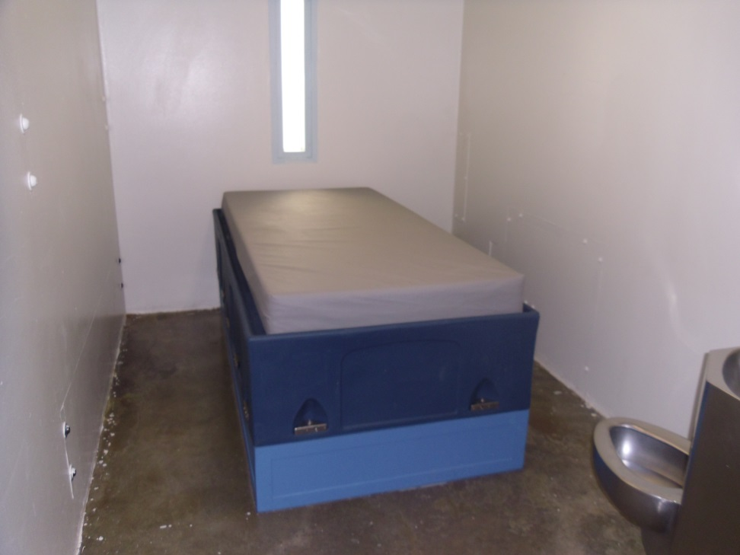
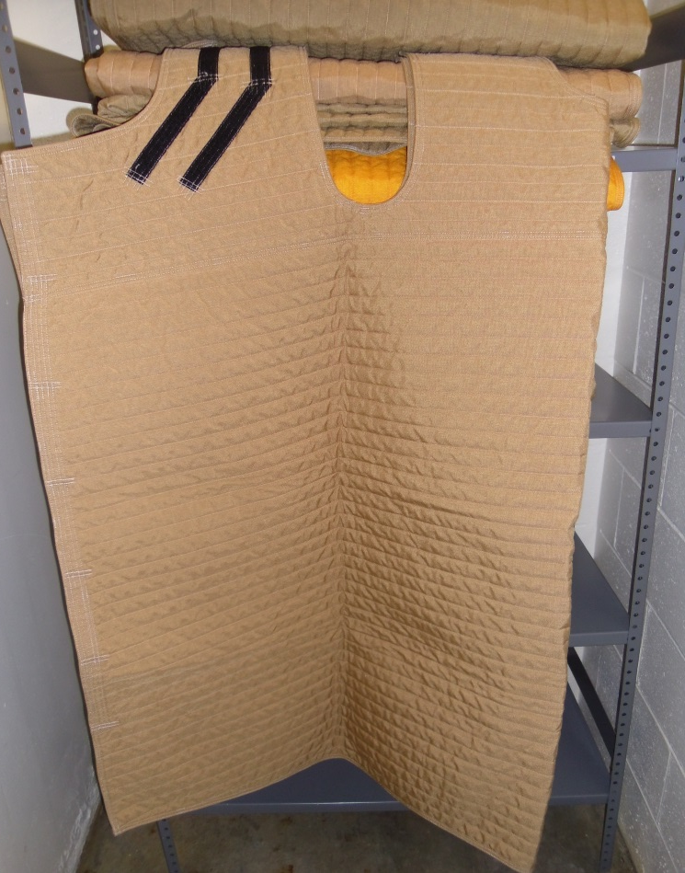
Safety Precautions Suicide Prevention/Intervention
Restraint Bed/Suicide Resistant Cell
Restrictive Housing –
Admit to ESU
Remain RISK or Partially Clear w/ re-evaluation every 24 hours until disposition is reached
Clear Precautions
Safety Smock/Blanket

Slide 12
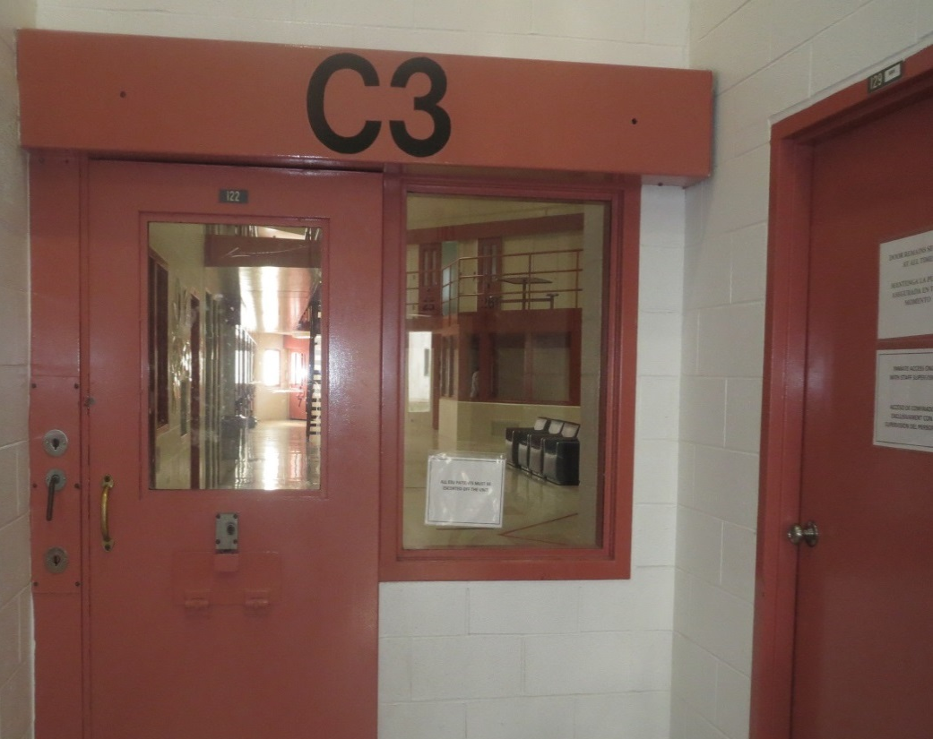
Evaluation & Stabilization Unit (MI)
The ESU (Evaluation & Stabilization Unit) is a maximum security inpatient treatment unit for individuals requiring short-term intensive psychiatric evaluation and treatment.
We have one of the 2 ESU’s in the state, the other is located in Middlesex County.
This is a regional program and patients can be admitted from the following counties for stabilization then returned to their county:
Worcester
Hampden
Hampshire
Berkshire
Franklin
This is a 15 bed inpatient unit w/ 3 restraint beds available.
There are an additional 16 beds on the top-tier to utilize for respites and step-down patients.

Slide 13
ESU Level System & Admissions
Utilize a Level Based system while providing treatment:
Level I w/ 1:1 observation
Level I
Level II
Level III
Step-down
Respites
Reasons for Admission:
Thoughts to harm others or oneself.
Attempts to harm others or oneself.
Struggling to manage in current housing unit.
Increase in symptoms.
Medication evaluations.
Unclear diagnoses.
Bizarre Behavior.

Slide 14
Mental Health Unit
The MHU is a medium security housing unit designed to provide enhanced treatment for individuals living with a mental illness.
Mental Health Staff and unit Staff utilize a Trauma Informed approach. With this approach, we treat all individuals with the assumption that they have experienced some type of trauma without needing to know the details of their past.

Slide 15
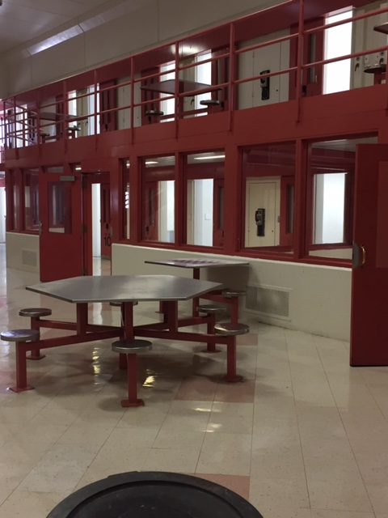
Mental Health Unit (MI)
HCSO MHU houses inmates with serious and persistent mental illness who have difficulty functioning in a general population unit. This is a 39 bed unit.
These individuals typically receive care thru DMH, or meet criteria for DMH Services.
Unit staff include MH Clinician, Correctional Counselor, and a Correctional Case Worker.
MH Counselors offer psycho-educational groups.
This unit is run like a general population unit in terms of privileges.

Slide 16
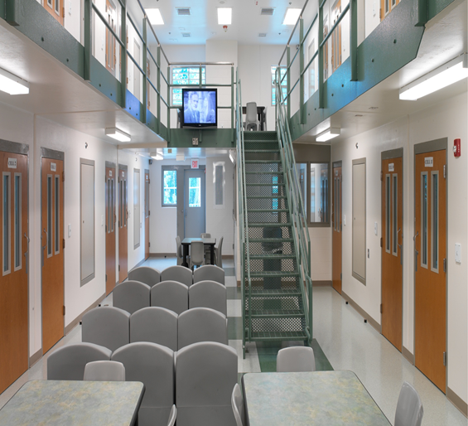
Evaluation & Stabilization Unit/ MHU (WCC)
The ESU (Evaluation & Stabilization Unit) is a maximum security inpatient treatment unit for individuals requiring short-term intensive psychiatric evaluation and treatment.
Mixed Classification unit, MHU is located on the top tier.
We have the only ESU in the state, for justice-involved Women.
This is a regional program and patients can be admitted from the following counties for stabilization then returned to their county:
Franklin
ESU: 11 bed inpatient unit
MHU: 12 bed living unit

Slide 17
Evaluation & Stabilization Program
This is a program that we utilize at Stonybrook Stabilization and Treatment Center (SSTC) as there is no specific unit, currently, set aside at these facilities to have an ESU.
SSTC does have a MHU and they house ESP clients in the same area as well as 3 other areas if needed.
The ESP program follows the same leveling system that we follow on the ESU.

Slide 18
Opioid Treatment Program & Medically Assisted Treatment
Methadone was delivered to York Street Jail (Springfield, MA) daily via Providence Hospital staff to treat opioid addiction; this practice began in the late 1980’s and continued through the early 90’s
Methadone – for pregnant women, 1993
Buprenorphine – Main Institution, 2007
Vivitrol – HCSD participated in a study, Project New Hope, with Yale University, 2011
Vivitrol MAT Pilot – Western Massachusetts Correctional Alcohol Center, Springfield, MA, 2013
Opioid Treatment Program (OTP), offering Buprenorphine (Subutex), Methadone, and Naltrexone (Vivitrol) – September 1, 2019

Slide 19
OTP Services at HCSO
July 2023 OTP services transitioned from CODAC to HCSO’s Mental Health Services.
BHN continues to provide OTP Discharge planning:
Continuation – Seen within 5-7 days of intake
New Induction – After being seen by a MH Clinician client is referred to Med Provider; Discharge Planner meets within 5 days before the Provider meeting
Pre-Trial & Sentenced on OTP – Seen within 5 days before court, within 5 days after if return from court (pre-trial)
Bridge
Works with clients in their last six months of incarceration
Bi-weekly check-ins; weekly in the month before release

Slide 20
OTP Education
All patients enrolled in the OTP are required to attend OTP Education
Groups are facilitated by the Care Coordinators
Group education occurs twice a week for five weeks
Topics include
Orientation to the Opioid Treatment Program
Treatment Team
Substance Use Disorders & Compulsive Behaviors
Overdose Prevention
Medication for Opioid Use Disorder Options
Substance Use Treatment & Chronic Illness/conditions
Substance Use Disorder Treatment for individuals with Co-Occurring Disorders
Family and Relationships within Recovery
Pathways of Recovery
Relapse Prevention & Recovery Maintenance Plans

Slide 21
OTP Discharge Planning
Population | Frequency of Discharge Planner Sessions
Pre-Trial | Within 2 business days of referral Within 5 days prior to Court Date Within 5 days after Court Date Otherwise, every 30 days
Sentenced | Within 5 days from referral Every 30 days Once 60 days to potential release, every 2 weeks Within 5 days prior to release
S35 | Within 5 days from referral Every 2 weeks

Slide 22
Keeping Track with OTP Assistant
Database developed by HCSO to monitor:
Dosing
Appointments
Referrals
Upcoming items due (forms/assessments)
Outside appointments upon release
Statistics
Notes:
Re-entry planning starts at day 1 of incarceration or commitment at HCSO!

Slide 23
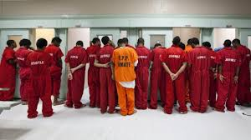
Specialty Unit: Youthful Offenders
Goal:
To reduce the likelihood of recidivism by addressing the unique issues associated with Juvenile or Youthful Offenders including emotional abuse, physical abuse, sexual abuse, emotional neglect, physical neglect, family violence, household substance abuse, household mental illness, parental absence, and household member incarceration.
Notes:
CJR Laws established a task force to evaluate the advisability, feasibility and impact of changing the age of juvenile court jurisdiction to defendants younger than 21 years of age. The study must include, but not be limited to:
(i) the benefits and disadvantages of including 18 to 20 year olds in the juvenile justice system;
(ii) the impact of integrating 18 to 20 year olds into the under-18 population in the care and custody of the department of youth services;
(iii) the ability to segregate young adults in the care and custody of the department of youth services from younger juveniles in such care; and
(iv) the potential costs to the state court system and state and local law enforcement.
The task force must consider resources and facilities, if any, that could be reallocated from the adult system to the juvenile system and the advisability and feasibility of establishing a separate young adult court for persons aged 18 to 24.

Slide 24
Youthful Offender Unit MAGIC Program
Mission
To promote and encourage youth towards their next steps in personal development through a supportive, relational program that helps interrupt beliefs, attitudes, habits, and behaviors supportive of a criminal lifestyle in favor of productive and positive futures.
Meaningful
Accomplishments
Gain
Increased
Character
“Your thoughts determine your actions.”

Slide 25
Educational and Treatment Programs
GED
College Courses offered
Institutional jobs –
Maintenance, welding, carpentry, graphics, prison industries
At Minimum Security this may include community based work crew (Springfield Parks, Old Armory Grille, Tree Services program).
Psycho-educational Treatment programs/classes:
SAVR: Stress Anger Violence Reduction
Self-regulation, behavior regulation, how to manage emotional reactivity with goal of improving personal well-being and compassion for others
Yoga/Mindfulness
CBT Skills
Healing Trauma
Anger Management
Substance Use Units

Slide 26
Emotional Support Division
In addition to Molly, there are 3 other Emotional Support Animals that are assigned to different areas of the Department (Training, Medical, and Security)
Pet Therapy started in October 2020 at the Main Institution with individuals classified to Mental Health Unit/Admitted to Inpatient level of care.
Clients are provided with the opportunity to have individual treatment sessions with Molly when completing a mental health evaluation.
Animal Assisted Treatment Groups include: WCC for V.O.I.C.E.S participants.
Roles of Emotional Support Animals include:
Providing a therapeutic environment for the inmates at all HCSO facilities
Giving the staff of HCSO the ability to interact with Therapy Dogs
Provide community outreach at schools, hospitals, nursing homes, etc.
Molly: Joined the department in July 2020.

Slide 27
Mental Health Aftercare Planning
Crisis evaluations are completed by CHD for any individual in the facility Bailing or Released by the courts prior to being discharged to the community who are on RISK, ESU Level 1 or ESU Level 2.
Pre-Trail Services: provided with MH Resource packet, to include Community Clinics who offer walk-in intakes, numbers or BHN and CHD Crisis.
Sentenced: Outpatient appointments scheduled (unless client selects clinic that only offers walk in services).
CHD: provided with initial appointment within 1 week of release AND psychiatry appointment within 3 months of release date
BHN: created pathway for HCSO to submit via email to have set appointment, rather than walk-in.
Psychiatric Medications available at release: 30 day prescription with 2 refills to bridge 3 months until able to establish treatment in the community.

Slide 28
Stonybrook Stabilization Treatment Center Section 35
Section 35 is a Massachusetts law that allows a qualified person to request a court order requiring someone to be civilly committed and treated involuntarily for an alcohol or substance use disorder.
Who is considered a qualified person?
Police Officer
Physician
Spouse
Blood relative
Guardian
Court Official
The petitioner must go to the local court and file a written petition or affidavit for an order of commitment. Petitions may be filed at any District or Juvenile Court.

Slide 29
Stonybrook Stabilization Treatment Center
Criteria to meet for a Section 35 civil commitment
The person must have an alcohol or substance use disorder; and
There is a likelihood of serious harm to self or others as a result of their substance use disorder. If both criteria are met, the person will be involuntarily committed. A judge should order a commitment under Section 35 only when less restrictive alternatives are unavailable.
The statute states the commitment may be up to, but not exceed 90 days. The commitment may be less than the 90 days depending on the individual’s clinical needs and if they cease to meet the criteria for likelihood of serious harm to themselves.
https://www.mass.gov/service-details/section-35-the-process

Slide 30
Stonybrook Stabilization Treatment Center
Levels of Care at SSTC
Acute Treatment Services
Up to 10 days
Detox phase
Groups/classes
Assessment completed from Mental Health, Medical, and Counseling Staff to determine need for services while in programming
Clinical Stabilization/ Support Services
Once cleared from ATS, up to 90 days
Medically Stable
Discharge planning/referrals
Groups/classes
Counseling

Slide 31
All-Inclusive Support Services
As an AISS participant, the client will be assigned a caseworker.
The caseworker will work with he client to help them meet their goals.
Some of the ways AISS can help the client includes:
ID and license assistance
Job search assistance
Education
Employment
Health insurance
SNAP (Food stamps)
Housing search assistance
Accessing substance abuse and mental health treatment
Counseling
Meeting requirements for DCF, probation or parole
Credit and banking assistance
Sealing criminal record
Free cell phone (must meet eligibility requirements)

Slide 32
Questions?
Contact Information
Karen Donelson MA, NCC, LMHC
Clinical Supervisor Hampden County Sheriff's Office
413-858-0255
Karen.donelson@SDH.state.ma.us

