Slide 1
Working with Victims of domestic Violence: Crisis, trauma, and Challenges
Sgt. Janet M. Griffin
Amherst Police Department

Slide 2

Reasons
A timely, logical and sensitive response increases reporting, enhances community confidence, and strengthens investigations thereby facilitating successful prosecutions.
Responding to the victim with dignity, respect and sensitivity will facilitate their participation in the justice system, and increase offender accountability

Slide 3

What is Crisis?
  A perception of an event or situation as an intolerable difficulty that exceeds the resources and coping mechanisms of the person
  Unless the person obtains relief, the crisis has the potential to cause severe behavioral malfunctioning

Slide 4
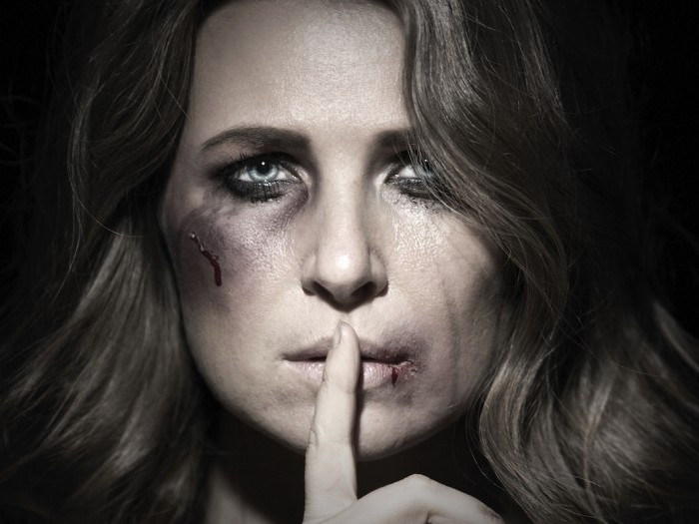

The Victim
Thinking pattern or belief system may be the primary reason victim does not seek help. Rigid thinking patterns by victims can drive them to respond in ways that appear illogical or unhealthy.
Victim’s core response to abuse is generally focused on self-preservation or keeping the children safe.
Fear
Self blame
Denial

Slide 5
Dynamics of Trauma
Age
Coping skills
Culture or belief system
Neurobiology
Severity of crime
Relationship to offender
Previous exposure to crime or violence
Previous experience with CJ system
Availability / effectiveness of overall support systems

Slide 6

Trauma response
This can result in shock, dissociation and many other kinds of involuntary responses while the violence is happening.
Anger
Distrust
Substance use/abuse
Trouble regulating emotions
Hopeless
Struggle with memory recall

Slide 7
Trauma challenges
Pacing-talking fast
Not talking at all
Slow to answer questions
Unable to listen and/or understand what you are asking
Unable to read or comprehend
Confused memory - unable to recall details
Confusion as to time frame (20 minutes is 3 minutes)
Inability to focus or make a plan

Slide 8
Flight/Fight/Freeze | Dissociation | Stages
Beyond conscious control, victim does not get to choose | Feeling unreal, spacing out, check out completely Focus on object in room or memory | Immediate: Shock Denial Fear Shame
Freeze: Brain detects an attack & prohibits movement Brain & body paralyzed with fear - unable to move or speak. | Disconnect from the intimate violation that’s happening | Outward adjustment: Coping mechanisms crash Isolation Anxiety/Depression Sleeplessness Difficulty functioning
Fight/Flight: Fight effectively or Able to escape assault | Fragmented memory/holes in account of assault | Re-triggering/Resolution: Anniversary of traumatic event Not going away
May be crying or passively trying to get away from threat “Have to go home now”

Slide 9
Verbal de-escalation
  Empathy
  Direct identification with, understanding of, and vicarious experience of another persons situation, feelings and motives
  The experience of understanding another person’s condition from THEIR perspective
  Non-judgmental
  Avoiding judgments based on one’s personal and moral standards
  Acceptance and awareness
  Active listening
  A conscious effort to hear not only the words that another person is saying but, more importantly, try to understand the complete message being sent
  Block out distractions

Slide 10
What to DO
  Speak in calm, slow and clear voice
  You may need to repeat yourself
  Be patient / empathetic
  Try to reduce background noise/distractions
  Ask open-ended questions
  Obtain relevant info from others (family, friends, etc.)
  Respect dignity of individual without regard to sex, race, age, sexual orientation

Slide 11
Physical de-escalation
  Maintain calm composure
  Use slow, deliberate movements
  Body language
  Neutral face expressions
  Personal space
  Attempt same height and eye level

Slide 12
What to AVOID
  Crowding or “cornering” the individual
  Touching the individual unless you ask first or its essential for safety
  Minimizing abuse
  Inflammatory language (“you’re acting crazy”), victim blaming
  Shouting or giving rapid commands
  Making promises you may not be able to keep
  Telling the individual “I know how you feel”

Slide 13
Best practices:
Offender accountability
Inform the victim of your concern
Give victim rights
Provided safety planning & options
Connect with resources
“They made me feel I was not to blame or at fault and not crazy”

Slide 14

Its everyone's responsibility to treat people in a manner that provides the utmost respect and inclusion in the decisions that affect their lives, so they can participate fully in their own recovery process

Slide 15
Resources
2017 DV guideline
DA’s Office

Slide 16

Questions / Comments / Concerns

