Slide 1
Trauma and Children

Slide 2
Learning Objectives
Participants will gain a better understanding of the neurobiological effects of trauma on the brain
Participants will gain knowledge on ACE’s (Adverse Childhood Experiences) and how it impacts all areas of functioning throughout a persons life span (medical, social, psychological, and criminal justice) and puts individual’s at a greater risk for justice system involvement.
Participants will be able to identify common types of childhood trauma and adult trauma including symptoms of Post Traumatic Stress Disorder
Participants will be able to describe how law enforcement can interact with people in a trauma informed way.

Slide 3
Reptilian Brain
Brain stem and cerebellum. It operates on instinct and is responsible for the survival-related functions of the of the body.
The reptilian brain is most closely associated with body processing. Instinctive trauma responses, such as fight, flight, freeze, or startle responses, and crying for help are all examples of reptilian brain functions. The reptilian brain also controls the autonomic responses that we experience as body sensations and basic life-sustaining processes, like digestion, heart rate, body temperature, and respiration.

Slide 4
The mammalian brain “emotional brain”
The mammalian brain includes the thalamus, amygdala, and hippocampus.
This is the emotional or limbic brain, is responsible for our emotional and relational experiences.
Emotions lend another dimension to our experience by letting us know of our likes and dislikes
relationships, it’s responsible for us feeling drawn towards or away from things and for holding emotional memories of our experiences.
These experiences of shared pleasure or pain are also encoded as nonverbal memories of attachment experiences, laying down templates for expectations of future relationships.

Slide 5
The neocortex
The cerebral cortex, the frontal cortex, is the front structure of our brain and is split across the left and right hemispheres.
The right hemisphere is associated with creativity and intuition. It processes information in a more symbolic, implicit, and nonlinear fashion.
The left hemisphere, the more rational side, matures and develops through early adulthood. It contains most of our language abilities. This hemisphere of the brain processes information in an explicit, logical, analytical, and linear fashion.
It’s important for our functioning in a health lifestyle, that everything is integrated and linked.
This part of the brain is not fully developed until around age 25

Slide 6
How the brain reacts to repeated trauma
The development and functioning of the three parts of the brain rely heavily on our childhood experiences. This includes early attachment figures, conditions in our environment, and traumas.
If we have ongoing or repeated threats in life, our brains become hypersensitive to cues that remind us of those traumatic experiences.
We can then have intense emotional reactions to cues, and our reptilian brain will then automatically activate our survival/trauma response system

Slide 7
How the brain responds to trauma
1st Stair: The brainstem (the “reptilian” brain) is the oldest part of your brain. It’s responsible for most of your automatic functions, such as your heart rate, body temperature, and blood pressure. In addition, your brainstem coordinates movement, controls arousal, and processes sensory information.
2nd Stair: The limbic system (the “emotional brain”) is known for its link to emotional experiences and regulation. It’s also responsible for motivation and storing explicit memories. This your limbic system.
3rd Stair: The cortex is the youngest part of your brain and often perceived as the smartest. It’s responsible for attention, perception, awareness, thought, memory, language, judgment, and consciousness. This is your cortex.

Slide 8
What are Trauma Responses
Involuntary responses, reactions or behaviors, that one may engage in during times of high and or chronic/toxic stress. These involuntary responses can be from “real” or perceived threats.
Fight - anger
Flight - avoidance
Freeze - numbness
Appease - trying to “fix”

Slide 9
https://youtu.be/95ovIJ3dsNk?si=-5UnaWhcr4zAzS7Y

Slide 10
What are some examples of possible childhood trauma
Divorce
Bulling
Abuse (sexual, physical, emotional, verbal)
Parental/Caregiver MH/SA
Parental/Caregiver incarceration
Neglect
Multiple foster homes
Poverty
Exposure to violence
`

Slide 11
What is Traumatic isn’t always Dramatic

Slide 12
Adverse Childhood Experiences (ACES) Questionnaire
Section 1
A household member swore at, insulted, humiliated, or put you down in a way that scared you OR a household member acted in a way that made you afraid that you might be physically hurt
Someone touched your private parts or asked you to touch their private parts in a sexual way that was unwanted, against your will, or made you feel uncomfortable
More than once, you went without food, clothing, a place to live, or had no one to protect you
Someone pushed, grabbed, slapped or threw something at you OR you were hit so hard that you were injured or had marks
You lived with someone who had a problem with drinking or using drugs You often felt unsupported, unloved and/or unprotected

Slide 13
Adverse Childhood Experiences (ACES) Questionnaire CONT
Section 2.
At any point since you were born…
You have been in foster care
You have experienced harassment or bullying at school
You have lived with a parent or guardian who died
You have been separated from your primary caregiver through deportation or immigration

Slide 14
Adverse Childhood Experiences (ACES) Questionnaire CONT
You have had a serious medical procedure or life threatening illness
You have often seen or heard violence in the neighborhood or in your school neighborhood
You have been detained, arrested or incarcerated
You have often been treated badly because of race, sexual orientation, place of birth, disability or religion
You have experienced verbal or physical abuse or threats from a romantic partner (i.e. boyfriend or girlfriend)

Slide 15
Childhood trauma vs Adult trauma
Traumas that happen in childhood

Slide 16
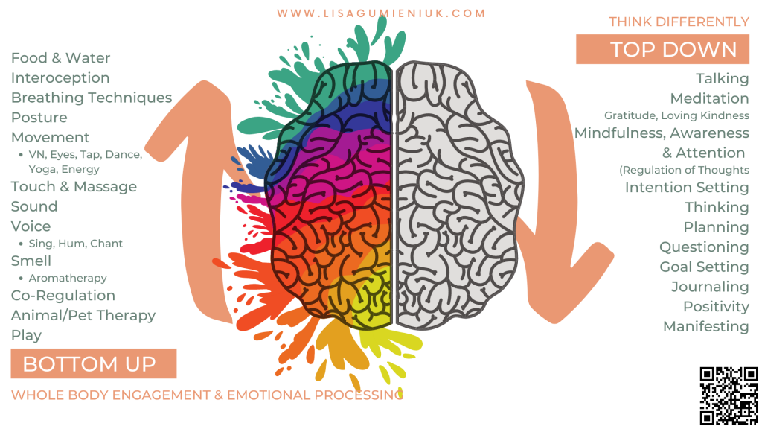
Top Down Bottom up

Slide 17
Top down bottom up
Set of stairs with first step being reptile brain, second being emotion part and third step being frontal lobe.

Slide 18
Bottom up approaches
Breathing
Water
Sensory input or elimination
grounding exercises- smells, tastes sights sounds touch
Trauma stored in body and emotion center of brain
Predictability, Safety, and Control

Slide 19
Trauma impacts the lower steps
Top down approaches work with the 3rd and sometimes 2nd step
Bottom up approaches work with the 1st and 2nd step
Trauma is stored in our “emotion center” 2nd and in our body 1st step
When someone is experiencing acute trauma response with are going to utilize bottom up approaches that target 1st and 2nd step
Childhood traumas are what really impact 1st and 2nd step as brain is not fully developed.

Slide 20
Increase bottom up interventions
War heads (strong tasting)
Playdough
Muscle tension (wall sits, planks)
Smells (essential oils on cotton swab)

Slide 21
Decrease top down interventions
Limit talking
Increase silence
Short declarative sentences
Ask permission when ever you can
Explain what you are doing or going to do or what will happen next

Slide 22
Direct vs indirect messaging
Direct verbal communication. Direct verbal messaging processes through frontal lobe
Indirect messaging is processed thought the emotional center and the brain stem. This is all the other types of communication, tone, body language, volume, facial expression etc
When a person is experiencing a trauma response, they are operating primarily from their emotional center and brain stem.

