Slide 1
Mental Health Disorders Overview
Matthew S. Leone, LMHC
Assistant Program Director
CHD CBHC

Slide 2
Overview
Approximately 1 in 5 adults in the U.S. (43.8 million, or 18.5%) experiences mental illness in a given year.
90% of those who die by suicide have an underlying mental illness.
Mental Illness results in more disability than:
  Cancer
  Diabetes
  Heart Disease
Notes:
NAMI Infographic

Slide 3
Consequences & Costs of Mental Illness
$193.2 billion in lost earnings per year.
Mood disorders are the 3rd most common cause of hospitalization for ages 18 to 44.
26 % of homeless adults in shelters have a MI
24% of prisoners have a history of a MI

Slide 4
What is Mental Illness?
Substantial disorder of
  Thought
  Mood
  Perception
  Memory
Can significantly impair judgment, behavior, capacity to recognize reality, or ability to meet the ordinary demands of life

Slide 5
Types of Mental Illness
Mood Disorders
  Depressive Disorders, Bipolar Disorder
Anxiety Disorders
Psychotic Disorders
Personality Disorders
Substance Use Disorders
Stress & Trauma-Related Disorders
Dissociative Disorders
  Dissociative Disorders
Notes:
This is a lot of information , maybe more than we need

Slide 6
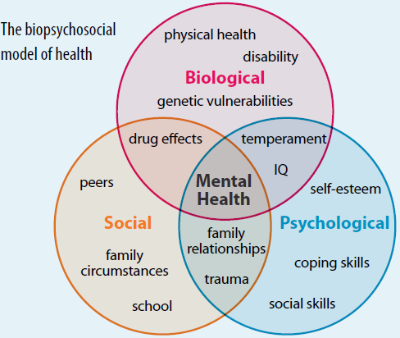
Causes

Slide 7
Biological Factors
  Biochemical Disturbances
  Genetics
  Infections- can cause brain damage
  Brain defects or injury
  Prenatal damage
  Poor nutrition, exposure to toxins

Slide 8
Social/Environmental Factors
  Significant life events: Death, divorce, changing jobs/school
  Significant local/world events
  Disasters
  A dysfunctional family life, including domestic violence
  Living in an unsafe environment
  Living in poverty
  Feelings of inadequacy, low self-esteem, or loneliness
  Social or cultural expectations
  Substance abuse

Slide 9
Psychological Factors
  Severe psychological childhood trauma, such as emotional, physical or sexual abuse
  An important early loss, such as the loss of a parent
  Neglect
  Poor ability to relate to others

Slide 10
What is severe, persistent mental illness (SPMI) ???
Complex symptoms
Often requires ongoing treatment and management.
Most often requires varying types and dosages of medication, therapy, and support.
Can vary in intensity and acuity.

Slide 11
The Good News?
Mental illness is treatable and people can recover.

Slide 12
The not so good news??
Nearly 60% of adults with a MI do not receive treatment
Nearly 50% of youth (8yrs to 15 yrs.) do not receive treatment
African American and Hispanic Americans used mental health services at about one-half the rate of whites.
Notes:
NAMI Multicultural Infographic

Slide 13
The single most common barrier to seeking treatment?
Shame
and
Stigma

Slide 14
Anxiety Disorders
Occasional anxiety and worry are a normal part of life.
Anxiety disorders involve more than temporary worry or fear.
The anxiety does not go away, can get worse over time, and can interfere with daily activities.
Most anxiety disorders begin in childhood, adolescence and early adulthood.
Notes:
NAMI Infographic
Fight, flight or freeze
Approximately 40 million American adults (18yrs. and older), about 18%, have an anxiety disorder.
Approximately 8% of children and teens.
Occur slightly more often in women than in men, and occur with equal frequency across most racial groups.

Slide 15
Anxiety Disorders
Panic Disorder
Obsessive Compulsive Disorder *
Post Traumatic Stress Disorder
Social Anxiety Disorder
Specific Phobias
Generalized Anxiety Disorder

Slide 16
Symptoms of Anxiety Disorders
Feelings of panic, fear and uneasiness
Uncontrollable, obsessive thoughts
Repeated thoughts or flashbacks of traumatic experiences
Nightmares
Ritualistic behaviors, such as repeated hand washing
Problems sleeping
Cold or sweaty hands
Shortness of breath
Palpitations
An inability to be still and calm
Dry mouth
Numbness or tingling in the hands or feet
Nausea
Muscle tension

Slide 17
Anxiety Disorders:
Why someone may call 911
Experiencing panic attack symptoms
Extreme worry
Child won’t go to school
Feel like they are “going crazy”

Slide 18
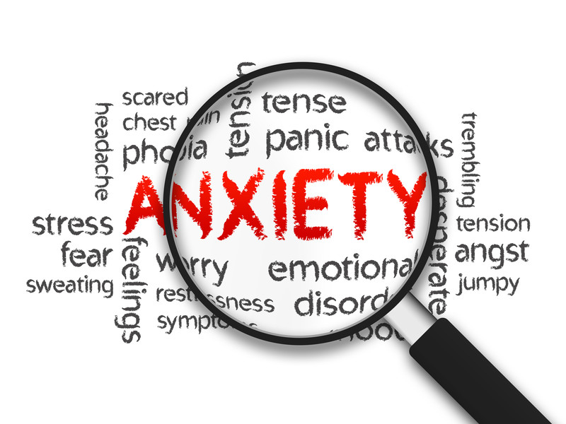
Communication & Response
Encourage slow ,deep breaths
If this is difficult for the individual, ask him to do it with you
Reassure
Speak slowly & calmly
Notes:
Encourage the person to slow down, take deep breaths.
“I want to understand what you are saying, but you are talking really fast. Let’s take some deep breaths together.”
Some people talk rapidly when they are stressed or scared. People who are manic often talk very rapidly

Slide 19
Types of Depression
Situational/Adjustment
Bereavement
Seasonal
Dysthymia
Post-Partum Depression
Bipolar depression
Clinical Depression
Psychotic Depression

Slide 20
Clinical Depression
An illness, not a weakness
Serious disturbances in work, social, and physical functioning including suicidal thought
Not relieved by circumstances
May last for months or years untreated
Persistent and intense mood change
Notes:
Approximately16 million adults (7%) in the US each year
Fewer than half seek treatment
1 of 4 women and 1 of 10 men develop depression during their lifetime
Often begins in early adult years.
Family history, substance abuse, and stress increase risk

Slide 21
Clinical Depression: Signs & Symptoms
Extreme sadness, guilt, shame
Decreased memory and concentration, poor academic performance or work performance
Decreased interest/enjoyment in daily activities
Increased irritability, arguments
Change in sleep, appetite, energy
Physical unease
Social withdrawal
Hopelessness, helplessness
Suicidal thoughts

Slide 22
Depressive Disorders:
Why someone may call 911
Suicidal thoughts
Hopelessness
Family, friends, providers may call for wellbeing check

Slide 23
Bipolar Disorder
Also known as manic depression.
A disorder that causes unusual shifts in mood, energy, activity levels, and the ability to carry out day-to-day tasks.
Episodic extremes between states
  depressed state and excitable,
  euphoric/irritable, impulsive state
Notes:
2.6% general population over a lifetime; 5.7 million adults.
Half of cases begin before age 20; median age is 25.
Strong family linkage
Occurs equally in men and women

Slide 24
Symptoms of Bipolar Disorder
Symptoms of mania ("the highs"):
  Excessive happiness, hopefulness, and excitement
  Sudden changes from being joyful to being irritable, angry, and hostile
  Restlessness
  Rapid speech and poor concentration
  Increased energy and less need for sleep
  High sex drive
  Tendency to make grand and unattainable plans
  Tendency to show poor judgment, such as deciding to quit a job
  Drug and alcohol abuse
  Increased impulsivity
  Can become psychotic

Slide 25
Bipolar Disorder:
Why someone may call 911
Manic symptoms
Grandiosity
Placing self in unsafe situations
Missing Person

Slide 26
Personality Disorders
People with personality disorders have extreme and inflexible personality traits that are often distressing to the person and/or cause problems in work, school or social relationships.
The patterns of thinking and behavior significantly differ from the expectations of society and are so rigid that they interfere with the person's normal functioning.
Examples include: antisocial personality disorder, obsessive-compulsive personality disorder, paranoid personality disorder, and borderline personality disorder.

Slide 27
Personality Disorders:
Why someone may call 911
Suicidality
Anger, aggression
Connection
Relationship issues

Slide 28
Schizophrenia Spectrum and Other Psychotic Disorders
Schizophrenia
Schizoaffective Disorder
Delusional Disorder
Schizotypal (Personality)
Brief Psychotic Disorder
Schizophreniform Disorder
Substance/Medication-Induced Psychotic Disorder
Psychotic Disorder Due to Another Medical Condition
Notes:
Psychosis may also occur with Major Depression and Bipolar Disorder
Approximately 2.4 million American adults, or about 1.1% of the population age 18 and older in a given year, have schizophrenia.
Schizophrenia affects men and women with equal frequency.
Schizophrenia often first appears in men in their late teens or early twenties. In contrast, women are generally affected in their twenties or early thirties.

Slide 29
Schizophrenia
  Schizophrenia is a chronic and severe mental disorder that affects how a person thinks, feels, and behaves.
  People with schizophrenia may seem like they have lost touch with reality, often experiencing delusions and hallucinations.
  Symptoms lasts longer than six months, often with a decline in work, school and social functioning.

Slide 30
Positive Symptoms
“Positive” symptoms are psychotic behaviors not generally seen in healthy people. may “lose touch” with some aspects of reality.
Hallucinations
Delusions
Thought disorders (unusual or dysfunctional ways of thinking)
  Disorganized or incoherent speech
Movement disorders (agitated body movements)

Slide 31
Hallucinations and Delusions
  Hallucinations are unusual sensory experiences or perceptions of things that aren't actually present,
    Can involve all five senses.
  Delusions are false beliefs that are persistent and organized, and that do not go away after receiving logical or accurate information.

Slide 32
Negative Symptoms
“Negative” symptoms are associated with disruptions to normal emotions and behaviors.
“Flat affect” (reduced expression of emotions via facial expression or voice tone)
Reduced feelings of pleasure in everyday life
  Slowed or unusual movements
Difficulty beginning and sustaining activities
Reduced speaking

Slide 33
Cognitive Symptoms
The cognitive symptoms of schizophrenia can be subtle or more severe.
Symptoms include:
  Poor “executive functioning” (the ability to understand information and use it to make decisions)
  Trouble focusing or paying attention
  Problems with “working memory” (the ability to use information immediately after learning it)

Slide 34
Psychotic Disorders:
Why someone may call 911
May call due to reality disturbance
Paranoia
Concern from family, friends, providers, etc.
Danger to self or others
Not caring for self

Slide 35
Psychosis
The 3 possible responses to a person who loses contact with reality, and are either hallucinating or delusional, are:
Agree with them
Dispute them, or
Defer the issue
Which is the appropriate response: A, B or C?
Notes:
Applying all of the de-escalation skills/strategies to specific situations.
Just be curious…
Goal is to validate the individual’s situation without agreeing with their perceptual experience.
Indicate that you understand that the experiences are real and may be frightening for the individual.
Remember to maintain a safe “reactionary” distance of from the individual.
You may have to repeat a reassuring message many times before the individual can respond to it. Repeat: “I’m here to help; I am not going to hurt you.”

Slide 36
Delusions
Convey your acceptance—but let the individual know that you are not experiencing it and reinforce reality.
“I can hear that you are scared that someone is out to get you, but I don’t know of anyone who is trying to hurt you . . . I’m here to help you and keep you safe.”
Don’t argue about the delusion—no one will win this argument
Notes:
Validate individual’s position: “I would be pretty scared too if…”
Paranoid delusions can lead to dangerous behavior because they cause a great amount of fear.

Slide 37
Are childhod disorders diferent from adult disorders?
Many diagnoses are the same across the lifespan, but the symptoms can appear different at different ages.
Some diagnoses are pretty commonly made in childhood/adolescence rather than in adults. Primary examples: ADHD, Oppositional Defiant Disorder, Conduct Disorder, Disruptive Mood Dysregulation Disorder.

Slide 38
How are Childhood Disorders Diagnosed?
Through observation
Through reports from adults involved with the child
Accurate diagnosis should involve input from multiple sources of observation/information.
Childhood diagnoses are particularly subject to change and re-evaluation over time due to the child’s development

Slide 39
Police might see kids with ADHD when:
When they run out of school, or away from home
They act out in school or at home, and become physically aggressive or destructive of property
They are involved in impulsive crimes, like shoplifting – they may tend to be followers rather than leaders

Slide 40
That’s because –
Problems with attention, focus and follow-though –
Poor planning skills – not anticipating consequences
Low frustration tolerance
Social difficulties – speaking or acting without thinking can alienate their peers

Slide 41
Untreated, ADHD/ADD is correlated with
Lower levels of educational achievement
Lower job satisfaction
Higher rates of substance use disorders,
Disruptions in family life,
Higher levels of incarceration

Slide 42
Keep in Mind -
ADHD and ADD are highly heritable disorders,– 30% of men who have ADHD will have at least one child with ADHD.
This makes behavior management challenging for these parents

Slide 43
Police might see kids with Oppositional Defiant Disorder/Conduct Disorder when:
They are picked up for minor infractions such as curfew violations,
or more serious actions such as breaking and entering, selling and/or receiving stolen goods, drug use, physical aggression or property destruction,
They violate a CRA or probation agreement
50-60% of youth in the juvenile justice system have some type of behavioral health diagnosis or mental illness

Slide 44
That’s because -
Youth with these disorders are chronically defiant and resistant to direction
They naturally come into conflict with all types of authority figures.
They are also planners, rather than acting on impulse, so they may be engaged in more high-stakes behavior
Their school/home discipline issues often spill over into aggression

Slide 45
Commonly treated with:
Medications to lessen any level of impulse disorder that may be complicating the picture
Other medications to help with controlling aggressive outbursts or mood swings
But – their behavior issues often lead to the legal system

Slide 46
Keep in mind -
Behaviors may appear purely oppositional but may really be a response to
Chaotic or unstable home environments, trauma, or other undiagnosed disorders
Kids may be communicating something with their behavior that they do not have the verbal skills or trust level to communicate in other ways
Notes:
Judge Baker Trauma Info - ACES

Slide 47
Police might see youth with Mood Disorders (Depression, Anxiety disorders, Bipolar disorder) when:
They exhibit self-destructive or aggressive behavior, in the home or at school
Parents become concerned over statements they make threatening harm towards themselves or towards others
They are involved in conflicts in the community with peers or authority figures

Slide 48
Youth with mood disorders are at high risk for suicide attempts and for self-injurious behavior.
Suicide is the 3rd leading cause of death for youth 10-14 and the 2nd for youth 15-34
They may engage in cutting, or develop eating disorders, and there are online communities that promote this behavior and normalize it for affected teens

Slide 49
Teens with these disorders are also highly vulnerable to predators, especially if they do not have a supportive social network in place – and especially online, where most parents will be unaware of their child’s activities

Slide 50
That’s because –
Adolescents are developmentally programmed to seek out peer approval
They naturally want to “belong” with peers rather than with adults
This means that if they are not able to feel comfortable with a naturally occurring peer group they will find a peer group elsewhere, whether online or elsewhere

Slide 51
Commonly treated with:
Medications to reduce the symptoms of mood swings, depressed mood
Psychotherapy, cognitive behavioral therapy, group therapy, peer group support
Youth compliance with medications becomes particularly problematic in the later teens when the stigma of having a mental health diagnosis is more pronounced and teens start to try out alternative “natural” ways of dealing with their mood instability
Psychotherapy, cognitive behavioral therapy, group therapy, peer group support

Slide 52
Keep in Mind -
Medication compliance is a problem in the later teen years because of stigma
Youth may prefer to use “natural” remedies that seem more socially acceptable
This can lead to increased symptoms and parents may not be aware that teens are not taking their medications or are self-medicating

Slide 53

Police may see Youth with Psychotic disorders when:
Symptoms of psychotic disorder in youth are not substantially different from those of adults with psychotic disorders –
When youth experience a first psychotic episode, parents may reach out for assistance
They may call 911 for help getting their loved one to a hospital or other site for evaluation or treatment.

Slide 54
Keep in Mind -
Experience and environment impact all aspects of development.
This includes mental health/emotional development.
Many of the children who need to receive mental health services have histories of trauma or come from extremely stressful environments.
They will benefit from supportive consistent activities and adults teachers, coaches and mentors

