Slide 1
Justine Cote, Education and Program Manager, at BIA-MA
Notes:
Tip to remember: When in doubt, don’t elaborate. You may want to say “Great question, but that is beyond the Scope of this training. I will share some additional educational opportunities at the end of this presentation.”

Slide 2
Helen Stewart, Outreach Coordinator, at BIA-MA
Notes:
Tip to remember: When in doubt, don’t elaborate. You may want to say “Great question, but that is beyond the Scope of this training. I will share some additional educational opportunities at the end of this presentation.”

Slide 3
OUR STORY
Through grassroot efforts a small group of family members came together in 1981 to address the need for brain injury services here in Massachusetts. These efforts created the Brain Injury Association of Massachusetts
The Brain Injury Association of Massachusetts was incorporated in 1982 as one of the first statewide brain injury associations in the U.S.

Slide 4
THE MISSION CONTINUES
Mission
To create a better future for individuals with brain injury and their families through advocacy, education, prevention, research and support.
Vision
To create a pathway for those impacted by brain injury to receive the right information, the right services, and the right support at the right time.
The Brain Injury Association of Massachusetts (BIA-MA) is a private non-profit organization that creates a better future for all those affected by brain injury.

Slide 5
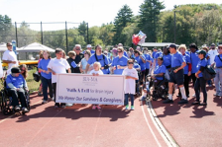
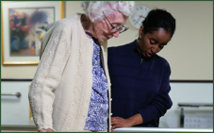
Public Policy
Prevention
Support
Education

Slide 6
DEDICATED TO CHANGE
In the last four decades BIA-MA
has played an instrumental role in:
Advocating for funding for individuals with brain injury at a State level
Helping shape services on a national level

Slide 7
PUBLIC POLICY
Establishment of the Statewide Head Injury Program (SHIP), within the Massachusetts Rehabilitation Commission, in 1985
Establishment of the trust fund (Head Injury Treatment Services: HITS) *Funds state services for people with traumatic brain injury
Instrumental in passage of the seatbelt law (1986), then passing the secondary Seat Belt Law (1993)
Hutchinson v. Patrick (Federal Class Action Lawsuit on behalf of individuals with acquired brain injury, 2008)
Notes:
Individuals cited for particular roadway infractions, infractions that put people at risk for brain trauma are fined for those violations, and these collected fines go to the HITS fund.

Slide 8
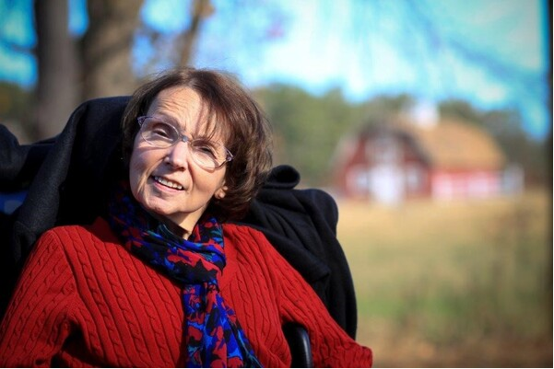
Catherine “Cathy” Hutchinson March 22, 1953-October 17, 2020
Lead Plaintiff
Hutchinson v Patrick federal class
action lawsuit
Human rights activist
Champion for the provision of
quality home & community-
based services
First woman to have robotic
arm surgery
Notes:
BIA-MA, Stavros Center filed in the Hutchinson v Patrick federal class
action lawsuit -lead plaintiff Catherine Hutchinson.
On June 2, 2008, a landmark settlement was reached that enables individuals with brain injuries to move out of nursing facilities and into the community. The right to live in the least restrictive environment.
Catherine Hutchinson Obituary:
file:///C:/Users/jcote/AppData/Local/Microsoft/Windows/INetCache/Content.Outlook/SMNIY815/Obituary%20%20Catherine%20Cathy%20Jane%20Hutchinson%20of%20Taunton%20Massachusetts%20%20Dyer-Lake%20Funeral%20Home.html

Slide 9
Hutchinson v Patrick Lawsuit Outcomes
Development and implementation of MassHealth Community-Based waivers for persons with Acquired Brain Injury
Discharge and transition of 713 individuals from institutional to residential community settings (12/31/20)
Discharge and transition of 474 individuals to non-residential settings (12/31/20)
Notes:
MA State Waiver Programs are services one may receive outside of the state medicaid plan, there are several- refer to fact sheet or explain that this will be given to the group (when available) The Waiver allows MassHealth members to get needed health care and support services at home rather than in an institution.

Slide 10
PUBLIC POLICY
Recent/Current Initiatives include:
In the last three legislative sessions, an additional $4,930,157 increase for SHIP
In January 2021, the Omnibus Health Care Bill passed requiring commercial health insurance plans, the Group Insurance Commission (GIC) and Mass Health to cover cognitive rehabilitation for COVID-19 patients
Cognitive Rehabilitation Bill (S629/H1078) will require commercial health insurance plans to cover cognitive rehabilitation after ABI

Slide 11
PUBLIC POLICY
Recent/Current Initiatives include:
Head Injury Treatment Services Trust Fund Bill (S941/H164) will increase funding by increasing fines under the trust fund
Acquired Brain Injury Advisory Board Bill (S83/H1078) will establish a permanent legislative advisory board on ABI and will continue the work of 2019 ABI Commission

Slide 12
AQUIRED BRAIN INJURY COMMISSION
To advance the present scope of community-based long term supports and services available to individuals with brain injury in Massachusetts by providing an analysis of current services, quality of service delivery, the related needs and gaps relative to access, capacity and resources, and to subsequently develop a series of prioritized recommendations for system change with a focus on positive outcomes for affected individuals.

Slide 13
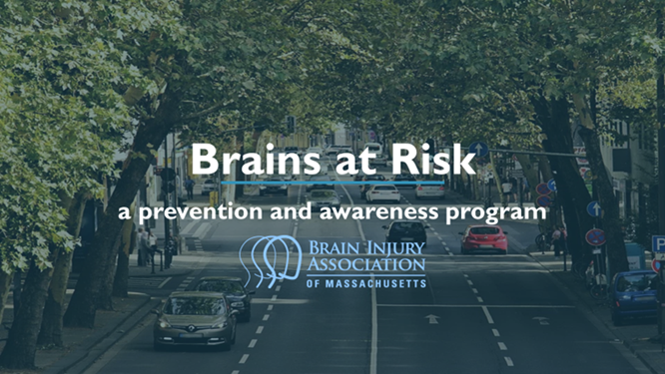
PREVENTION
BIA-MA offers several programs that educate the community on brain injury prevention.
Notes:
Think A-Head- is a dynamic school-based program that has been teaching students to avoid risk-taking behavior and develop healthy living habits. BIA-MA has visited hundreds of Massachusetts schools and educated thousands of students!!
Brains At Risk- is an awareness and prevention program that links dangerous and risky driving behaviors to the devastating effects of traumatic brain injury (TBI).
Survivors Voice- is similar to Brains At Risk but is specifically tailored to speak to those who are substance use treatment, and second offender DUI/OUI programs. All of these programs get to hear the personal stories of those whose lives have been permanently affected by brain injury that was caused by impaired or risky driving behaviors.

Slide 14
SUPPORT & RESOURCES
Promote the general welfare, rights and dignity of persons with brain injury
Promote and foster the empowerment of persons with brain injury
Assist survivors and families to obtain appropriate services and support
Provide information and resources for persons with brain injury, their families, friends, and professionals

Slide 15
Support Groups
Brain injury can have a traumatic effect on both survivors and their families. BIA-MA sponsors support groups that provide survivors and their loved ones a forum for sharing information, a compassionate and understanding peer group, and an opportunity to socialize and make new friends with others..
http://www.biama.org/groups.html
Notes:
Add in support groups are virtual until further notice but have been highly recommended and attended during the pandemic.
Put Support Group in the chat-explain the calendar can be found on that website, not sure which group is for you? Contact us @ info@biama.org

Slide 16
EDUCATION
Annual Brain Injury Conference
Acquired Brain Injury Clinical Continuing Education Series
Family and Survivor Education
Introductory Acquired Brain Injury Series
Notes:
Education/training for individuals, families, and professionals to foster understanding of the long-term impact of the injury
Review descriptions of each; and we will talk more on this at the end.

Slide 17
THE SCOPE of ACQUIRED BRAIN INJURY

Slide 18
WHAT is an ACQUIRED BRAIN INJURY ?
A range of disorders and diseases affecting the brain
Onset after birth, beginning in the newborn period throughout the lifespan
Majority who experience an ABI are adults

Slide 19
WHO IS AFFECTED ?
ABIs are experienced by both males and females
Thousands experience ABI annually in all regions of Massachusetts
Most individuals survive their injuries

Slide 20
CAUSES of ACQUIRED BRAIN INJURY (ABI)
INFECTIOUS DISEASES associated with disorders of the brain: meningitis/encephalitis caused by bacteria, viruses, parasites and other infectious agents
METABOLIC DISORDERS: which may be related to systemic disease (e.g., liver disease) or other conditions affecting the brain (e.g., anoxia: lack of oxygen)
NEUROTOXIC DISORDERS: includes brain injuries resulting from environmental or occupational exposure to toxins, such as metals (e.g., lead poisoning), gases (e.g., carbon monoxide), as well as drug and alcohol abuse

Slide 21
CAUSES of ACQUIRED BRAIN INJURY (ABI)
NEOPLASMS (BRAIN TUMORS): may be primary (arising within the brain), or secondary, representing metastases (spread) of cancer from another site (e.g., lung)
NEUROVASCULAR DISEASES and CONDITIONS: includes stroke (second leading cause of ABI)
TRAUMA: Traumatic Brain Injury (TBI), an externally-caused brain injury, is the leading cause of ABI

Slide 22
TRAUMATIC BRAIN INJURY (TBI)
LEADING CAUSE: FALLS
OTHER MECHANISMS: Firearms, motor vehicles, strikes by object/person, explosions (e.g., IEDs: improvised explosive devices)
CONTEXT: Sports/recreation; occupational; activities of daily living; interpersonal violence; military combat; child abuse; homicide and suicide attempts

Slide 23
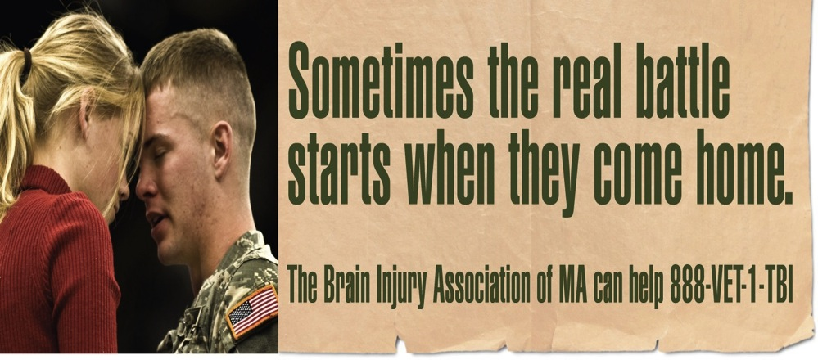

Slide 24
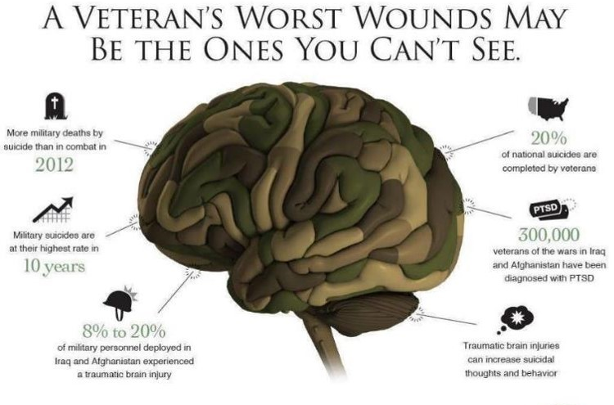
*Source: www.psychiatry.org

Slide 25
FACTORS AFFECTING OUTCOME and RECOVERY
Age at the time of the onset/occurrence of ABI
Site(s) of injury within the brain and severity of neurological insult
Specific disease or disorder

Slide 26
FACTORS AFFECTING OUTCOME and RECOVERY
Nature of complications
Premorbid conditions (e.g., psychiatric disorder)
Timeliness, accuracy, and access to diagnostic and treatment services
Health care disparities

Slide 27
FACTORS AFFECTING OUTCOME and RECOVERY
Other post-injury risks/factors (e.g., substance use disorder)
Participation in Rehabilitation
Support of family/significant others

Slide 28
CONSEQUENCES of ACQUIRED
BRAIN INJURY

Slide 29
FUNCTIONAL DOMAINS AFFECTED by ABI
MOTOR SKILLS (e.g., paralysis)
SENSORY FUNCTIONS (e.g., blindness)
COGNITION (e.g., memory impairment)
COMMUNICATION & LANGUAGE (e.g., aphasia)

Slide 30
CHANGES in PSYCHOLOGICAL and SOCIAL FUNCTIONING RELATED to ABI
Depression: most common mood disorder
Personality Changes
Social isolation & withdrawal
Post-Traumatic Stress Disorder
Anxiety

Slide 31
OTHER DISORDERS in PERSONS WITH ABI
Chronic headache & other pain disorders
Seizure disorders
Sleep disorders
Endocrine disorders (hormone disorders)

Slide 32
OTHER RISKS AMONG INDIVIDUALS WITH ABI
Substance Use Disorder (SUD)
Unemployment
Homelessness
Criminal charges/incarceration related to behavioral dysregulation

Slide 33
Educational Offerings
https://biama.org//forprofessionals/

Slide 34
Brains At Risk
https://biama.org//forthecommunity/

Slide 35
Introduction to Acquired Brain Injury Series
Designed as an introductory lecture series for staff working in residential & day programs, mental health centers, vocational and other community-based programs providing services to individuals with acquired brain injury, as well as those new to the field of brain injury.
Trainings presented in Zoom format (see BIA-MA website for scheduled trainings).
Organizations can also arrange for BIA-MA to provide these presentations for staff working in community-based programs.

Slide 36
Introduction to Acquired Brain Injury Series
To schedule a presentation for your organization contact:
education@biama.org

Slide 37
Introduction to Acquired Brain Injury Series
What is an ABI ?
Detailed overview of the types of ABIs, epidemiology, outcome, and clinical consequences.
Presenter: Francesca LaVecchia, Ph.D.
How to Communicate with Persons with Acquired Brain Injury
Review of the common communication disorders exhibited by persons with ABI, and strategies for successful communication and support.
Presenter: Therese O’Neil-Pirozzi, ScD, CCC-SLP

Slide 38
Introduction to Acquired Brain Injury Series
Understanding, Assessing and Responding to Challenging Behaviors related to Acquired Brain Injury
Review of the common cognitive-behavioral disorders associated with ABI and their neurological correlates. Components of a therapeutic environment; Positive Behavior Supports; and strategies for preventing and reducing the occurrence of challenging behaviors are presented and discussed in this two-session (6 hour) training.
Presenter: Susan Roberts, Ph.D.

Slide 39
Our purpose is to provide support to brain injury survivors and their families, offer programs to prevent brain injuries, educate the public on the impact of brain injury, and advocate for community services.
For more information:
www.biama.org 800-242-0030

Slide 40
Intellectual Property Statement
The content of this presentation represents the intellectual property of the Brain Injury Association of Massachusetts. Unless specifically noted, this presentation and handouts should not be replicated, recorded, or distributed without the written authorization of the Brain Injury Association of Massachusetts.

