Slide 1
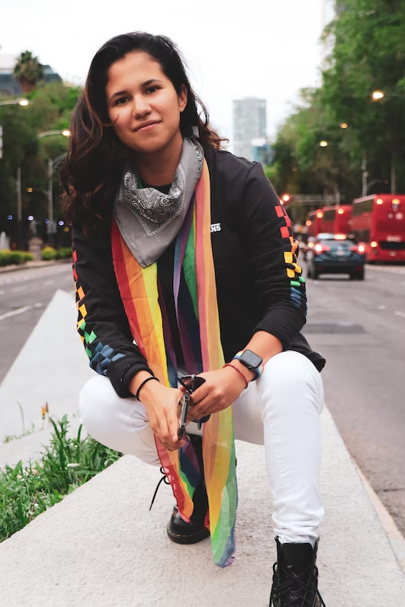
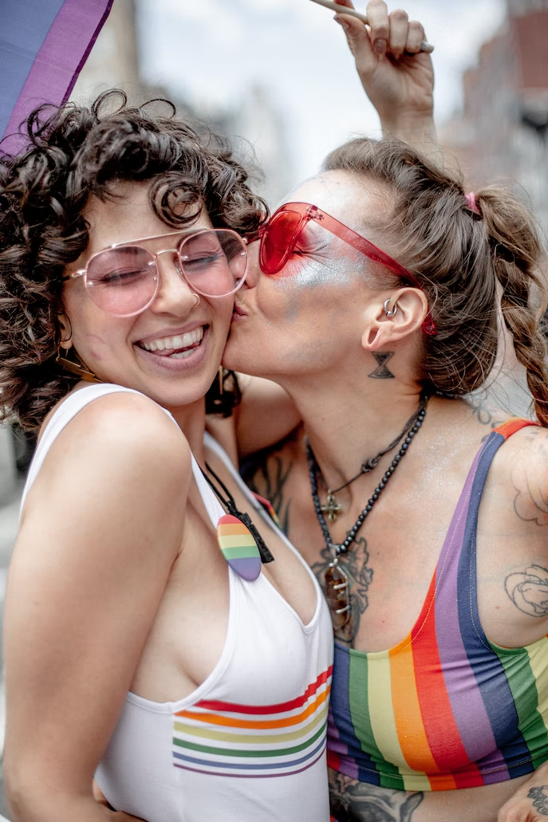
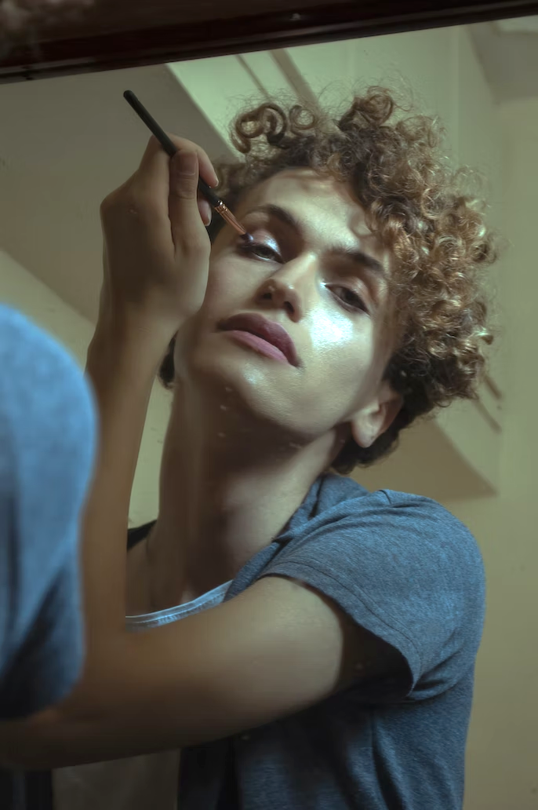
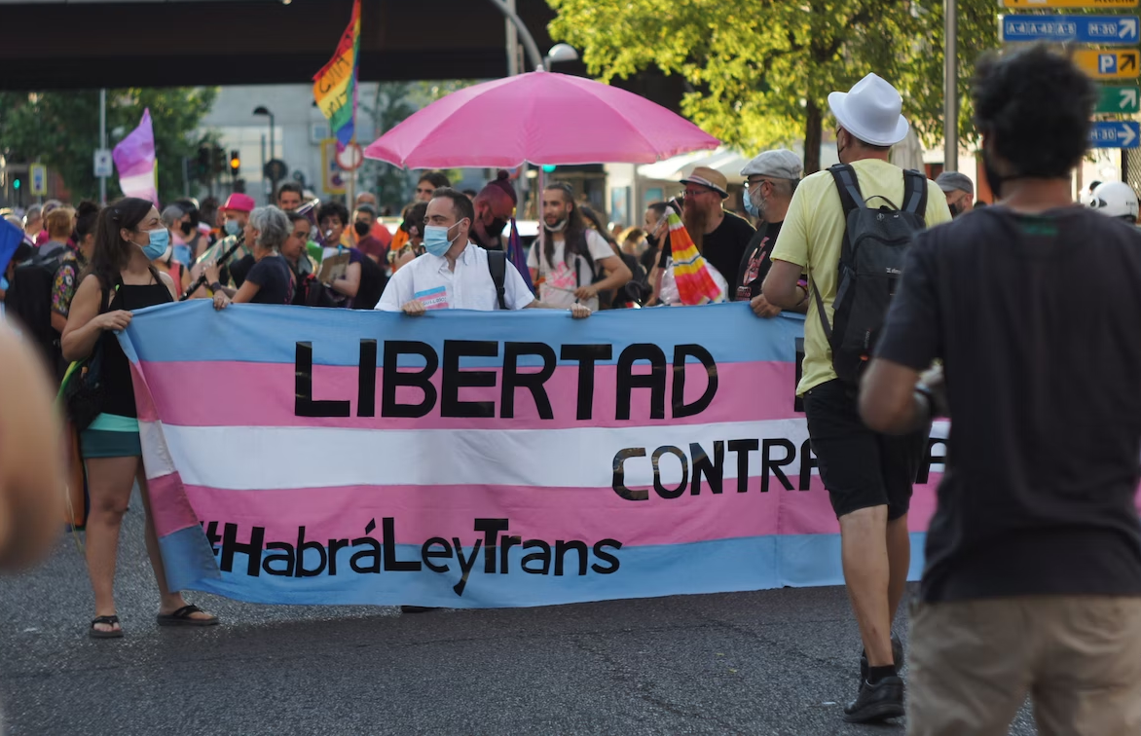
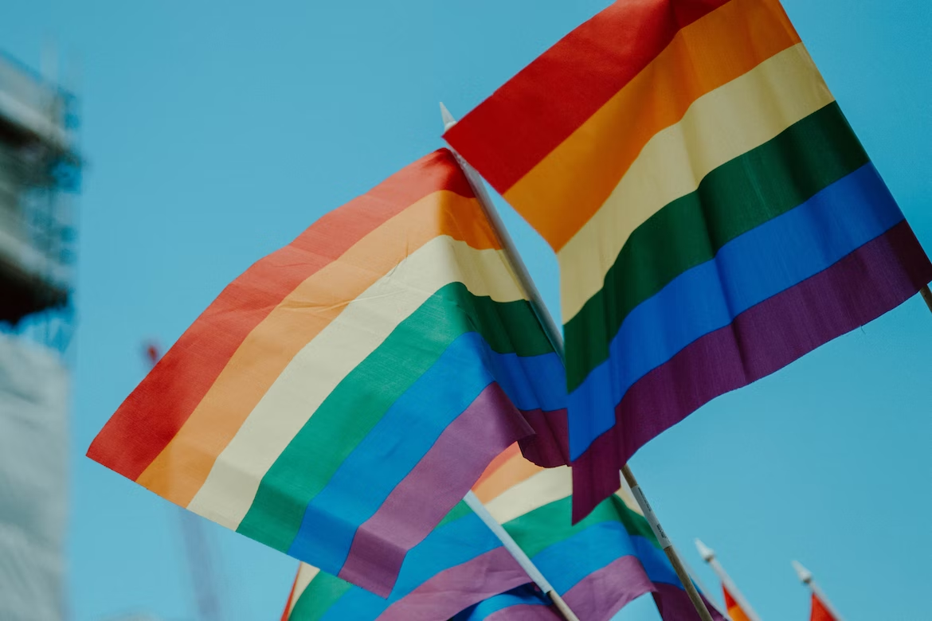
Gender and Community Allyship
Sarah Biette (they/she)
Notes:
Sarah

Slide 2
Tapestry - Who Are We?
Community-based nonprofit organization providing harm reduction services, sexual and reproductive healthcare, and WIC food & nutrition support to Western Massachusetts
Operating for the last 50 years!
Serve over 26,000 residents annually
15 locations across Berkshire, Franklin, Hampshire, and Hampden County
Access without stigma - we meet folks where they’re at, and provide them the care that they need
Notes:
Clem

Slide 3
Goals for Today:
Develop your own understanding of gender and sexuality terms
Understand the current situation for LGBTQ+ youth in the United States and Massachusetts
Learn how to support LGBTQ+ youth in your own work
Notes:
Sarah

Slide 4
Group Agreement
Everyone has different experiences with today’s topics
Some of you may be members of the LGBTQ+ community, others may have never discussed gender and sexuality before
Bring Light, Not Heat
Ask questions at any time
Raise your hand or ask an anonymous question on an index card
Be respectful of others and their comfort levels
If you need a break, feel free to go to the bathroom or get a drink of water
Don’t share someone else’s story without their permission
Are there any other ideas you’d like to add to this agreement?
Notes:
Sarah

Slide 5
Agenda
Introductions and Agreement
An Overview of LGBTQ+ Rights in the US
Support Looks Like → Education
Support Looks Like → Trust Their Experiences
Support Looks Like → Making Mistakes
Group Allyship Brainstorm
Notes:
Clementine

Slide 6
Why are we talking about LGBTQ+ identity today?
Notes:
Clementine

Slide 7
Hate Crimes Targeting LGBTQ+ People Are On the Rise
The 2022 FBI Crime in the Nation Report
The FBI reported a 19% increase in single-bias hate crimes against LGBTQ+ individuals
Total of 622 incidents nationwide
Anti-transgender bias rose more than 35% in 2022
Total of 338 incidents nationwide
In 2023, at least 32 trans people were killed due to their gender identity according to the Human Rights Campaign
The actual number is likely higher, reporting is difficult
Notes:
Sarah
Source: https://thehill.com/homenews/lgbtq/4259292-fbi-crime-statistics-show-anti-lgbtq-hate-crimes-on-the-rise/

Slide 8
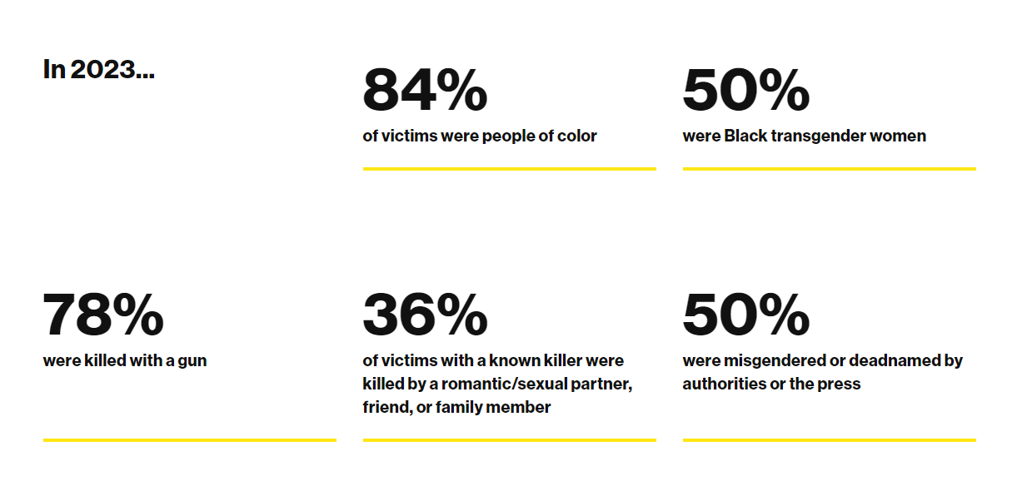
In 2023, at least 32 trans people were killed due to their gender identity
Notes:
Sarah
** At least, because this statistic is likely an underestimate
Source: https://www.hrc.org/resources/fatal-violence-against-the-transgender-and-gender-expansive-community-in-2023

Slide 9
LGBTQ+ Individuals Are More At Risk
More than 1 in 3 LGBTQ Americans faced discrimination of some kind in the past year, including more than 3 in 5 transgender Americans (Center for American Progress)
According to the National Network for Youth, 40% of youth experiencing homelessness identify as LGBTQ+
This number increases within BIPOC LGBTQ+ youth populations
45% of LGBTQ+ youth seriously considered attempting suicide in 2022
1 in 5 transgender and nonbinary youth attempted suicide in 2022
(Source: The Trevor Project Youth Mental Health Survey)
LGBTQ+ people experience discrimination when accessing healthcare, leading to poorer overall health outcomes and delays in care (Source: Center for American Progress)
479 anti-LGBTQ+ bills have been introduced across the US in 2024 so far (ACLU)
Notes:
Sarah
https://nn4youth.org/lgbtq-homeless-youth/
https://www.thetrevorproject.org/survey-2022/
https://www.americanprogress.org/article/discrimination-prevents-lgbtq-people-accessing-health-care/
https://www.aclu.org/legislative-attacks-on-lgbtq-rights-2024

Slide 10
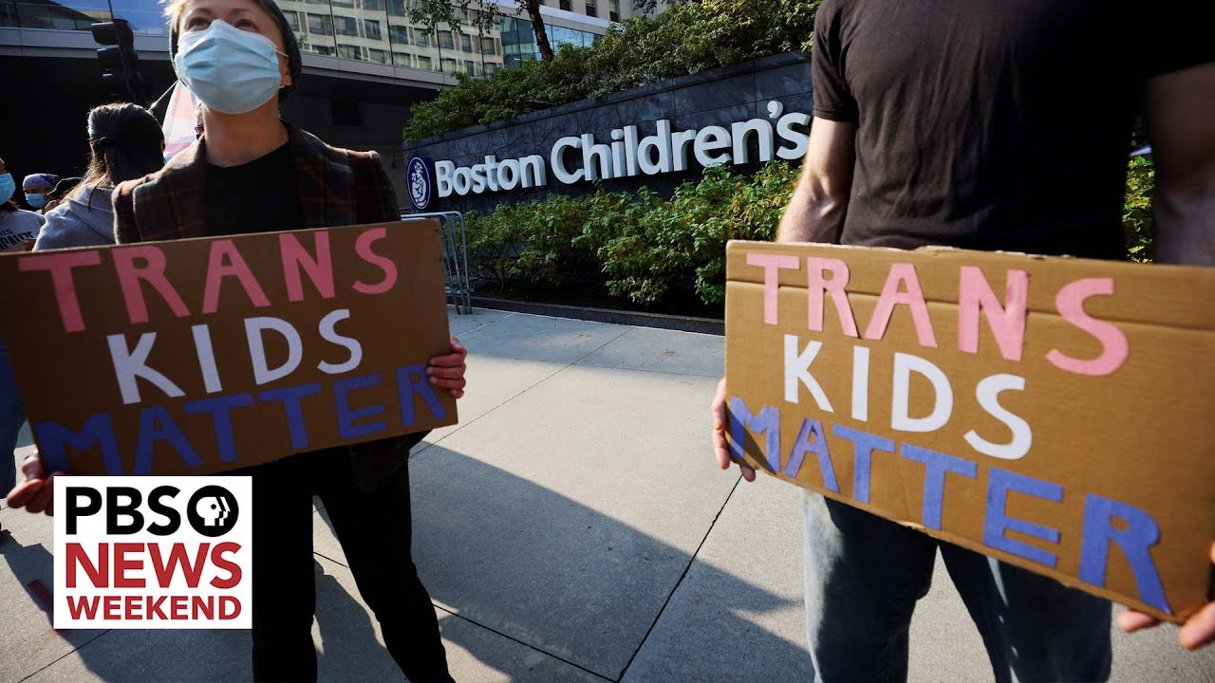
Trans Rights in Massachusetts
Doctors and hospital staff at Boston Children’s Hospital have received large amounts of harassment and threats. In 2022, the hospital received a bomb threat after misinformation about their gender affirming care gained national attention.
Notes:
Sarah
Source: https://www.pbs.org/newshour/show/childrens-hospitals-become-targets-of-anti-transgender-attacks-and-harassment

Slide 11
Trevor Project Mental Health Survey
60% of LGBTQ+ youth who wanted mental health care in the past year were not able to receive it
The primary reason cited was “fear of discussing mental health concerns”
Fewer than 1 in 3 transgender and nonbinary youth found their home to be gender affirming
73% of LGBTQ+ youth reported experiencing symptoms of anxiety
45% of LGBTQ+ youth seriously considered attempting suicide in the past year
1 in 5 transgender and nonbinary youth attempted suicide in the past year
Notes:
40,000 Youth Nationwide from 13-24

Slide 12
Things Are Difficult… And
96% non-LGBTQ Americans agree that schools should be a safe and accepting place for all youth (GLAAD)
91% of non-LGBTQ Americans agree that LGBTQ people should have the freedom to live their life and not be discriminated against (GLAAD)
LGBTQ+ youth who report having at least one accepting adult were 40% less likely to report a suicide attempt in the past year (The Trevor Project)
Talking with them respectfully about their LGBTQ+ identity
Supporting their gender expression and using their pronouns
Educating themselves about LGBTQ+ people and issues
Notes:
Clementine
https://www.thetrevorproject.org/wp-content/uploads/2019/06/Trevor-Project-Accepting-Adult-Research-Brief_June-2019.pdf
https://glaad.org/publications/accelerating-acceptance-2023/
https://www.washingtonpost.com/dc-md-va/2023/06/14/lgbtq-rights-state-legislative-attacks/

Slide 13
Trevor Project Mental Health Survey
LGBTQ+ youth who found their school to be LGBTQ+ affirming reported lower rates of attempting suicide
LGBTQ+ youth who live in a community that is accepting of LGBTQ+ people reported significantly lower rates of attempting suicide than those that didn’t
LGBTQ+ youth who had high levels of social support reported significantly lower rates of attempting suicide than those that didn’t
89% of LGBTQ+ youth reported that seeing LGBTQ+ representation in TV/movies made them feel good about being LGBTQ+

Slide 14
Trevor Project Mental Health Survey
The five most common ways LGBTQ+ youth reported feeling supported by their parents, caregivers, and trusted adults
Being welcoming of their LGBTQ+ friends and partners
Talking with them respectfully about their LGBTQ+ identity
Using their name and pronouns correctly
Supporting their gender expression
Educating themselves about LGBTQ+ people and issues

Slide 15
What Does Support Look Like?
Educate Yourself
Trust Their Experiences
Make (and Fix) Mistakes
Notes:
Clem

Slide 16
Establishing a Baseline of Knowledge
In groups, brainstorm a definition for one of the following terms:
Gender Identity
Gender Expression
Sex Assigned at Birth
Sexual Orientation
Once you’re finished, you will share-out your definitions with the rest of the group!
Notes:
Clementine
Everyone in this room has an experience of gender! Identity is your internal sense of being a gender

Slide 17
Support Looks Like → Education
Gender Identity (Internal): One’s internal sense of being a man, a woman, neither of these, both, or another gender(s). Almost everyone has a gender identity, even if they haven’t thought about it much before. Your internal gender identity may or may not match your external expression of your gender (your gender expression)
Gender Expression (External): The physical manifestation of one’s gender identity through clothing, hairstyle, voice, body shape, etc. This manifestation may or may not match your internal perception of your gender (your gender identity).
Notes:
Sarah
Everyone in this room has an experience of gender! Identity is your internal sense of being a gender

Slide 18
Gender - the Internal and External
Gender Identity
I feel like a woman.
I don’t feel connected to the gender binary.
I am a man.
I have a fluid experience of manhood and womanhood.
Gender Expression
I like to have shorter hair.
I like how people treat me when I dress more masculine.
Wearing jewelry makes me feel good about myself.
Having a deeper voice is nice.
Notes:
Sarah
Gender expression can change day to day. Gender identity can also change multiple times. The way someone understands themself is going to be different from how you understand them because you are not them! The cool thing is that you don’t actually have to fully understand someone’s gender identity/expression/etc, to extend respect and care.

Slide 19
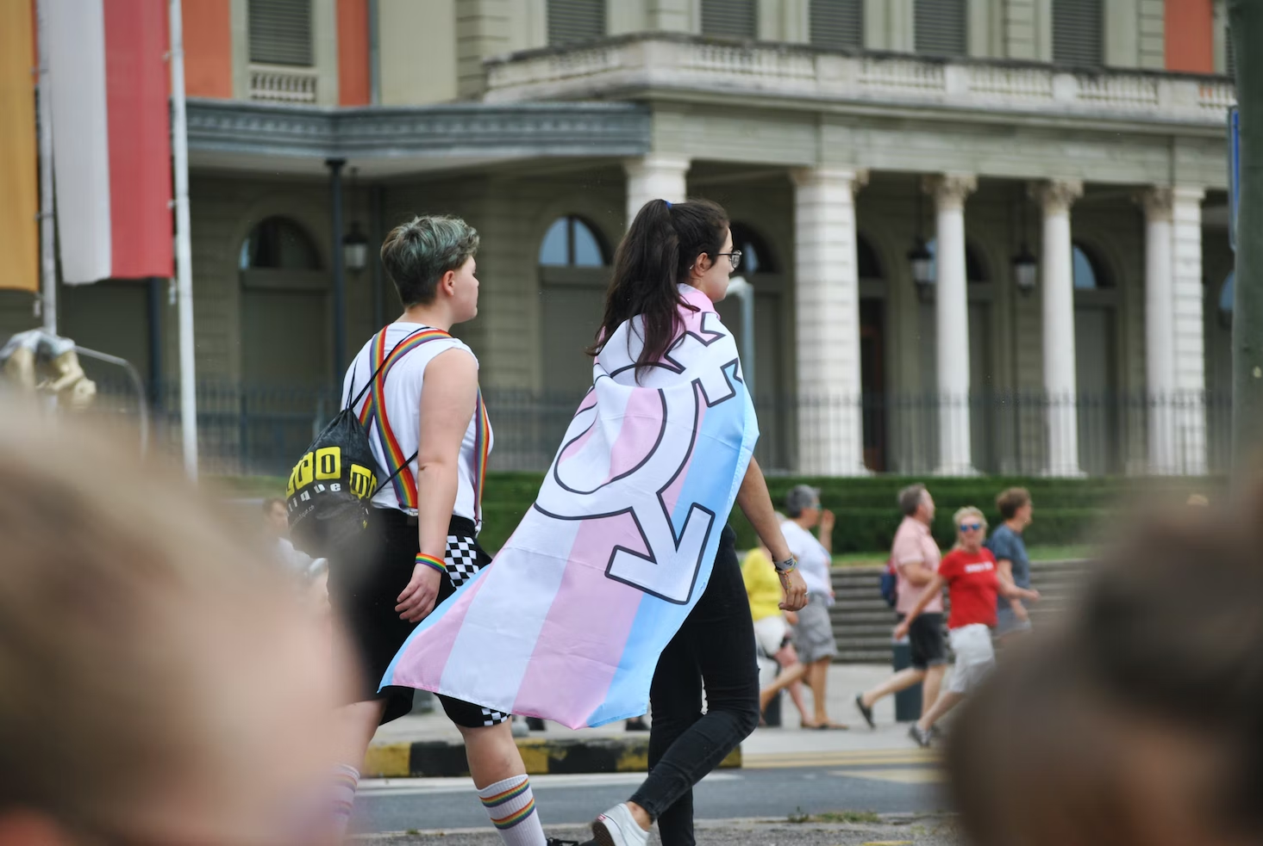
Gender ≠ Sex Assigned at Birth
Sex Assigned At Birth: Assigned sex is a label that you’re given at birth based on medical factors, including your hormones, chromosomes, and genitals. The assignment of a biological sex may or may not align with what’s going on with a person’s body, how they feel, or how they identify.
Notes:
Clementine

Slide 20
Physically Attracted To
Physically Attracted To: Sexual orientation. It is important to note that sexual and romantic/emotional attraction can be from a variety of factors including but not limited to gender identity, gender expression/presentation, and sex assigned at birth.
Notes:
Sarah

Slide 21
Emotionally Attracted To
Emotionally Attracted To: Romantic/emotional orientation. It is important to note that sexual and romantic/emotional attraction can be from a variety of factors including but not limited to gender identity, gender expression/presentation, and sex assigned at birth. There are other types of attraction related to gender such as aesthetical or platonic.
Notes:
Sarah

Slide 22
What Does Support Look Like?
Educate Yourself
Trust Their Experiences
Make (and Fix) Mistakes
Notes:
Sarah

Slide 23
Using (and not using) Identity Labels
Some folks may use labels to define their sexuality, or other aspects of their identity
Words like lesbian, bisexual, asexual, intersex, queer**
Some folks may choose not to use labels to define their sexuality
Some folks may use labels that you don’t understand or agree with
Labels are for an individual to claim, not an outsider to assign
Notes:
Sarah

Slide 24
Gender is important… and
Someone might be seeking support or assistance completely unrelated to their gender identity
They might view their gender and sexuality as a very small part of their whole identity
Don’t make a bigger deal out of either of these topics than someone is interested in. Practice reflective listening.
Notes:
Sarah

Slide 25
Connection Building Activity
Take a few minutes to write down the following:
(keep your answers secret!)
What are the most important relationships in your life right now?
What are the places that are special to you?
What events or topics do you discuss with your friends?
What do you enjoy doing in your free time?
What current events are of interest to you because they impact you directly?
Notes:
Tag team

Slide 26
Connection Building Activity
Find someone in the room you don’t know very well and have a brief conversation with them. Catch up on your week, your life, or your plans for the weekend.
DO NOT MENTION ANYTHING YOU WROTE DOWN ON YOUR PAPER!
Notes:
Tag team

Slide 27
Connection Activity
How did participating in this activity feel?
What do you think was the purpose of this activity?
Notes:
Tag team

Slide 28
What Does Support Look Like?
Educate Yourself
Trust Their Experiences
Make (and Fix) Mistakes
Notes:
Clem

Slide 29
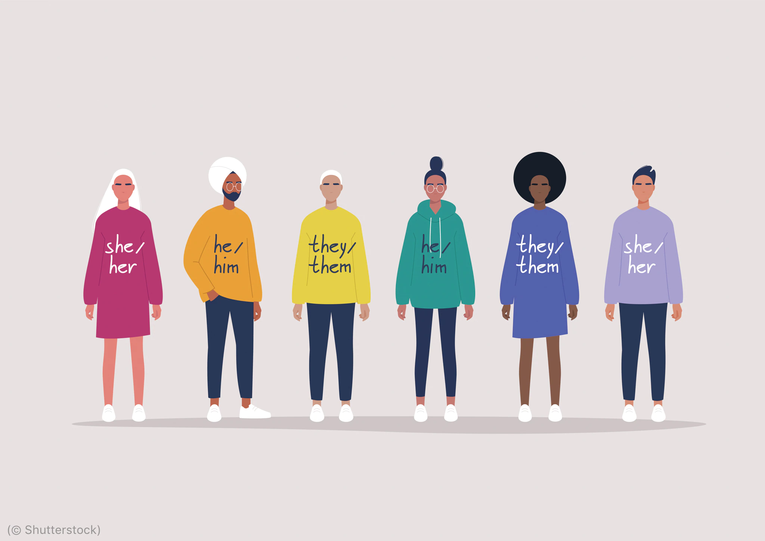
Pronouns!
Personal pronouns refer to the gendered words we use to replace names. For many, these are he or she.
However, some folks use pronouns that might not match their sex assigned at birth or their perceived gender.
Notes:
Clem

Slide 30
Pronoun Activity
With the person next to you, tell a 1-2 min story about a friend or family member. Use the pronouns “they/them” when referencing the person in the story. Try your best to use pronouns a couple of times throughout!
Notes:
Clem
How did this activity feel to do?
Did anyone find it easy? What about difficult? Emphasize that this is something I do frequently, it’s common to need to do for someone if you are getting used to new pronouns (i.e. try to tackle the “I’m just not good at this” mindset - everyone needs to work on it, even gender nonconforming people!)
Lead into the …. So that’s all great, but why are we discussing this? Transition

Slide 31
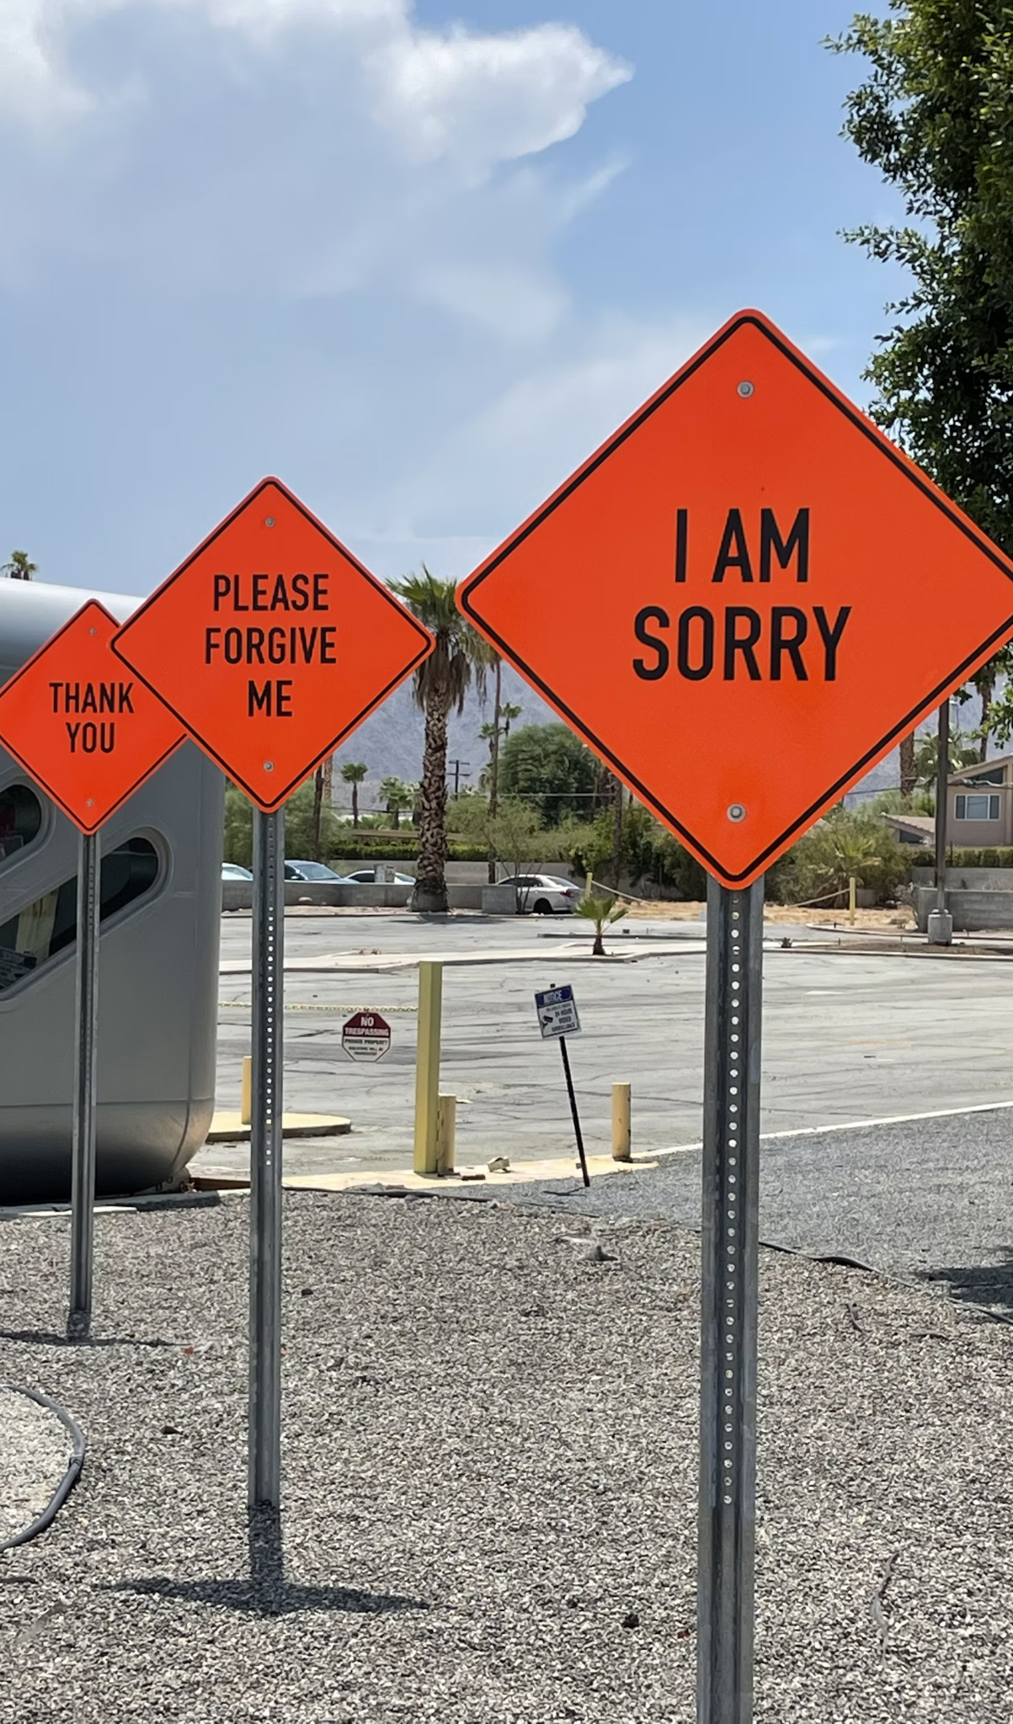
What if you make a mistake?
We make mistakes when talking about other’s identities all of the time
Repair misgendering someone the same way you would calling anyone the wrong name
Apologize briefly, correct yourself, and move on
Don’t make the apology about yourself!
Notes:
Clem

Slide 32
Creating Supportive Environments
People are the experts on their own identities
Avoid making assumptions
Gather only the information you need
Don’t ask for what’s irrelevant
Normalize diverse experiences
Labels may help, but respect is key
Associate risk w/ behavior, not identity
You don’t need to be an expert, you need to be an ally
Notes:
Sarah
Additional Source: https://transequality.org/issues/resources/supporting-the-transgender-people-in-your-life-a-guide-to-being-a-good-ally

Slide 33
Creating Supportive Environments
We’ve discussed many ways to support LGBTQ+ individuals within your work
Turn to the people around you and think of 2 concrete steps you can take today to better assist LGBTQ+ folks within your current position
These can be small changes, or big ones!
Notes:
Sarah
Additional Source: https://transequality.org/issues/resources/supporting-the-transgender-people-in-your-life-a-guide-to-being-a-good-ally

Slide 34
Local & National Resources
Notes:
Clem

Slide 35
Question Time!
Let me know if you have any questions! A copy of these slides, along with a feedback form and a resource sheet, will be shared via email after the presentation.
Notes:
Sarah

